Slide 1

Machine Translation In Alibaba
李龙来(Kevin Li)
Senior Developer
Citi Tech department

Slide 2
Contents
01
Why Ali Translator is needed
02
How to develop Ali Translator
03
Ali engineering technology
04
How to do a project in Alibaba

Slide 3
01
Why Ali Translator are needed
PART ONE

Slide 4

Ali translator-why need

Slide 5
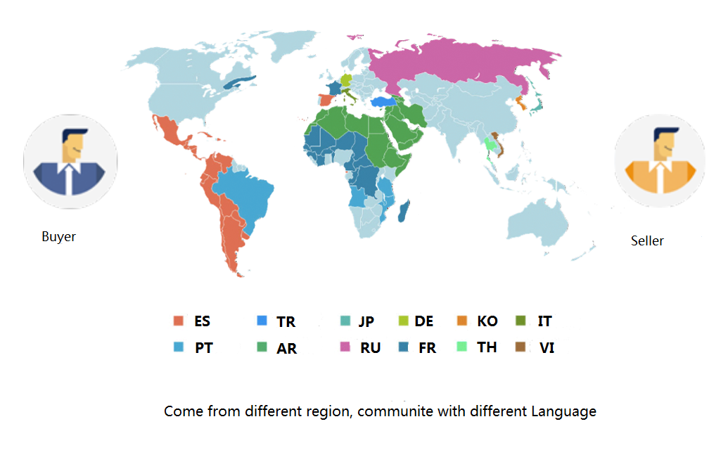
Ali translator-why need

Slide 6
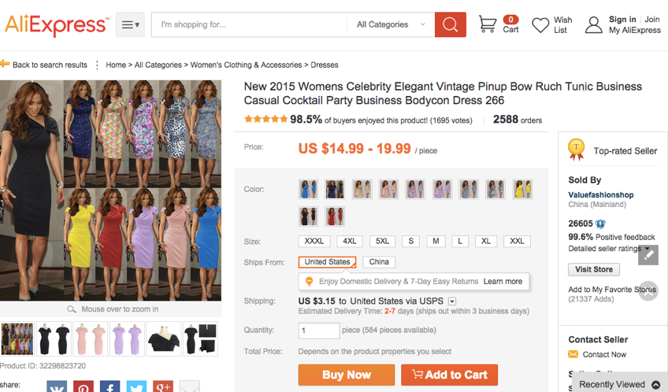
Ali translator-why need

Slide 7
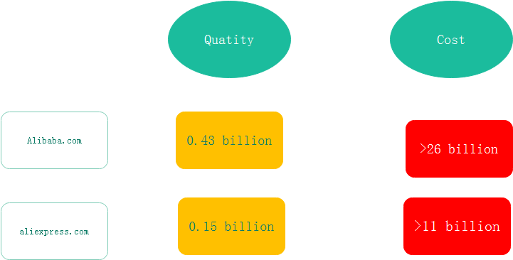
Ali translator-why need

Slide 8
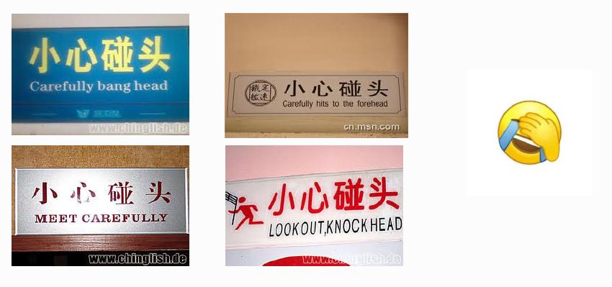
Ali translator-why need

Slide 9
02
How to develop Ali Translator
PART TWO

Slide 10
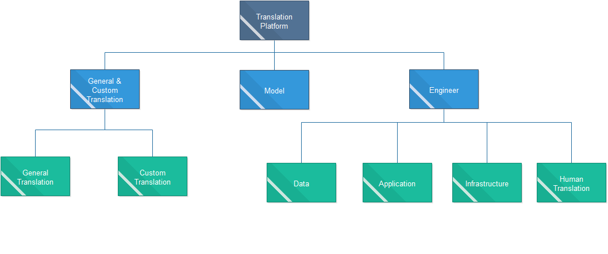
Ali translator-team
Base in Hangzhou, Beijing, US
请在此插入图片
Over 40 Researchers and engines
Group
Algorithm, Data, Infrastructure, Application, Crowd Source

Slide 11
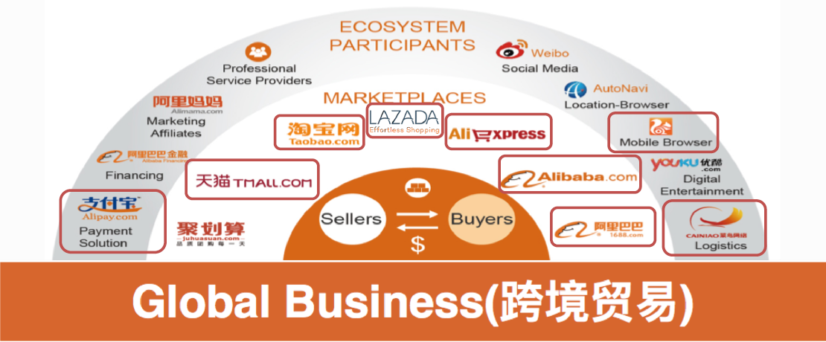
Ali translator-business side

Slide 12
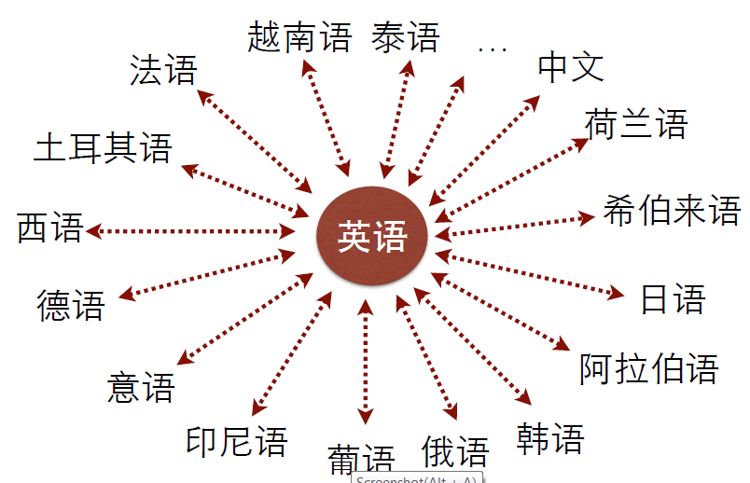
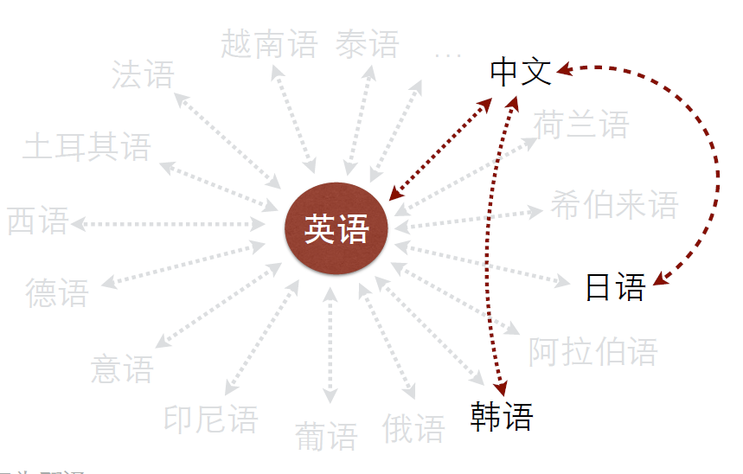
Ali translator-capacity

Slide 13
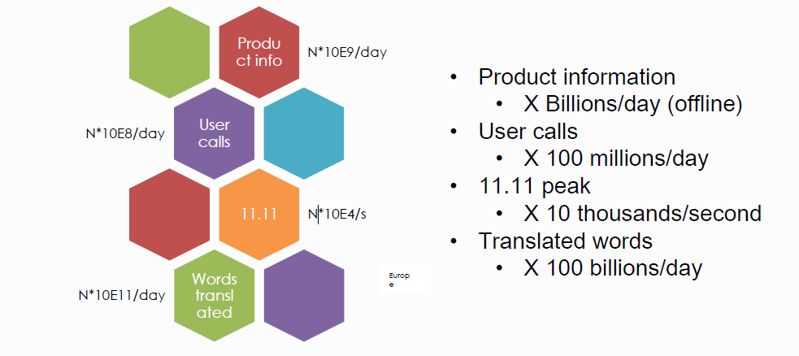
Ali translator-capacity

Slide 14
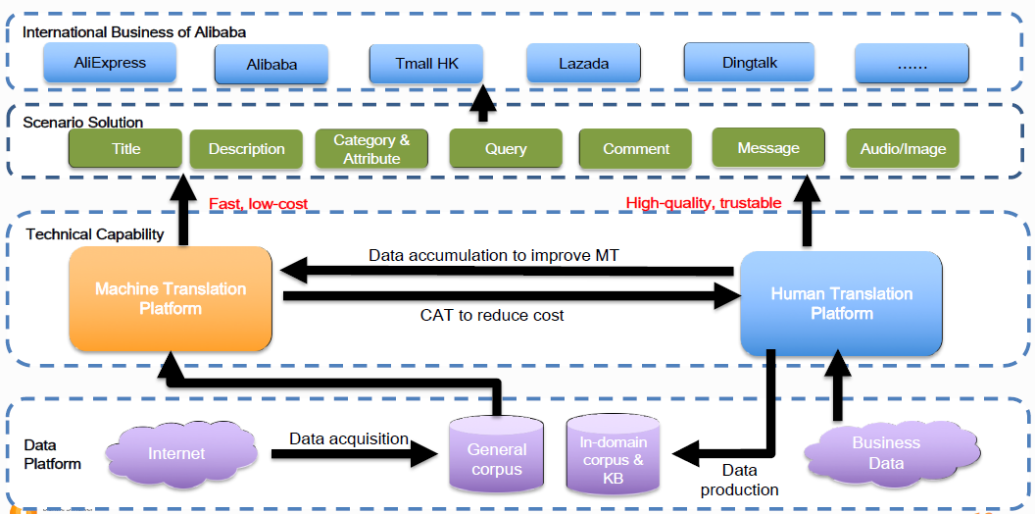
Ali translator-framework

Slide 15
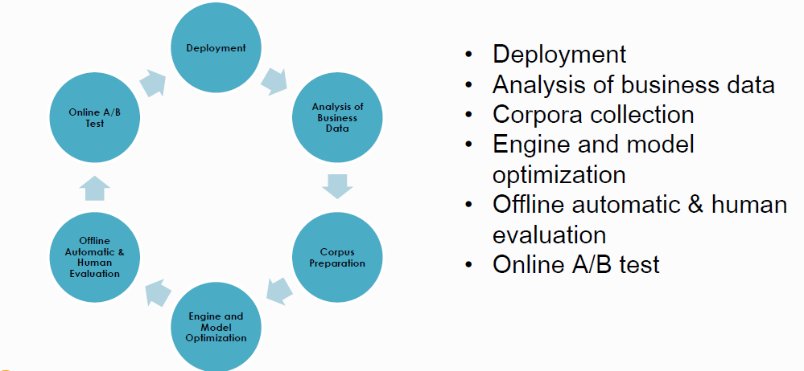
Ali translator-Translator Lifecycle

Slide 16
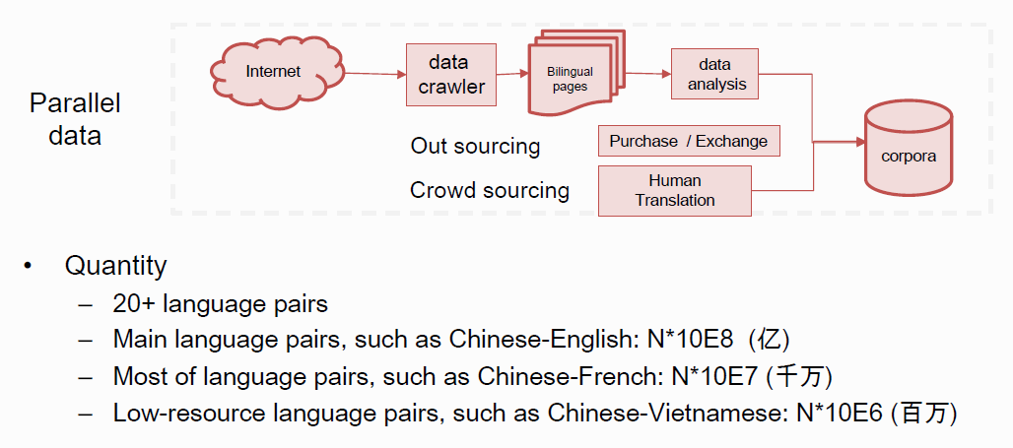
Ali translator-data

Slide 17
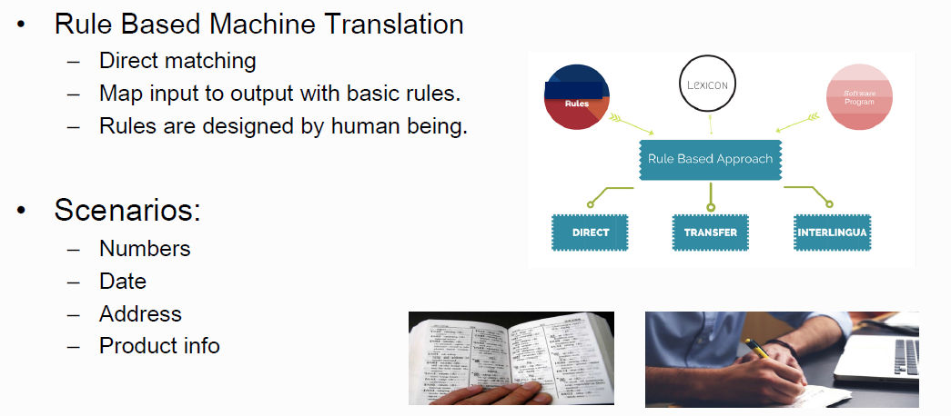
Ali translator-model

Slide 18
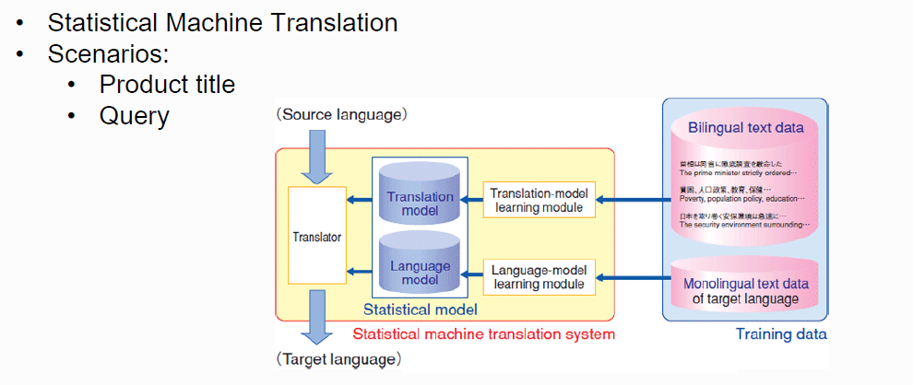
Ali translator-model

Slide 19
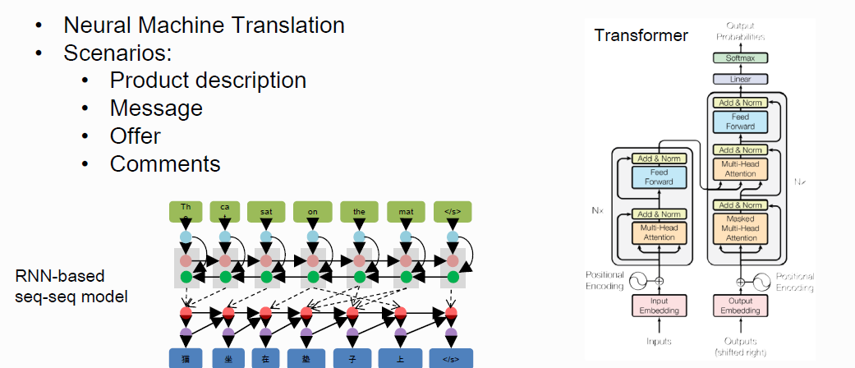
Ali translator-model

Slide 20
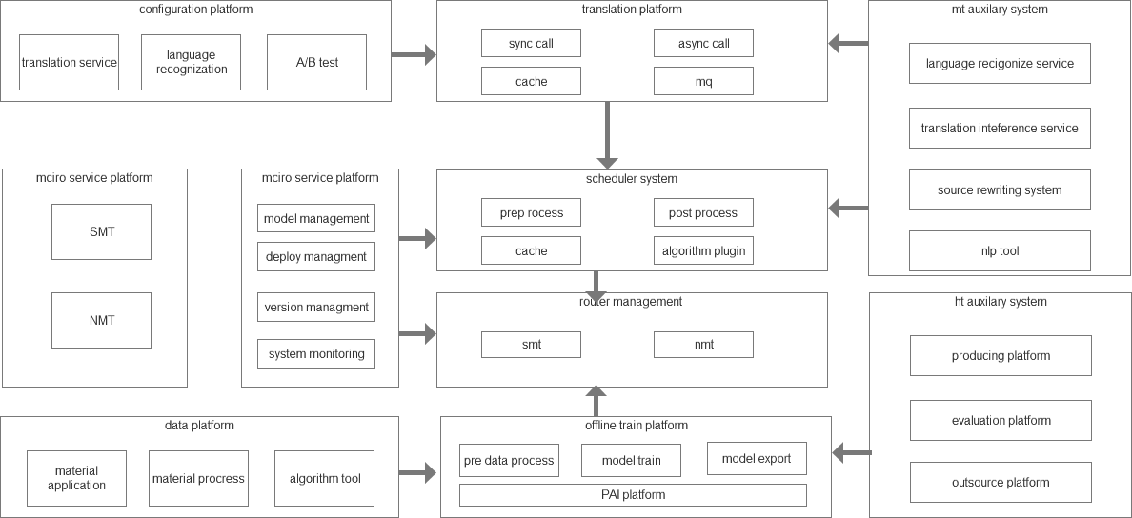
Ali translator-application

Slide 21
03
Ali engineering technology
PART THREE

Slide 22
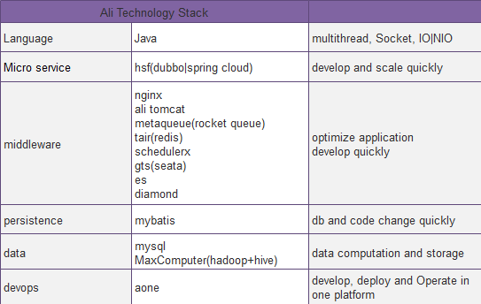
Ali-technology

Slide 23
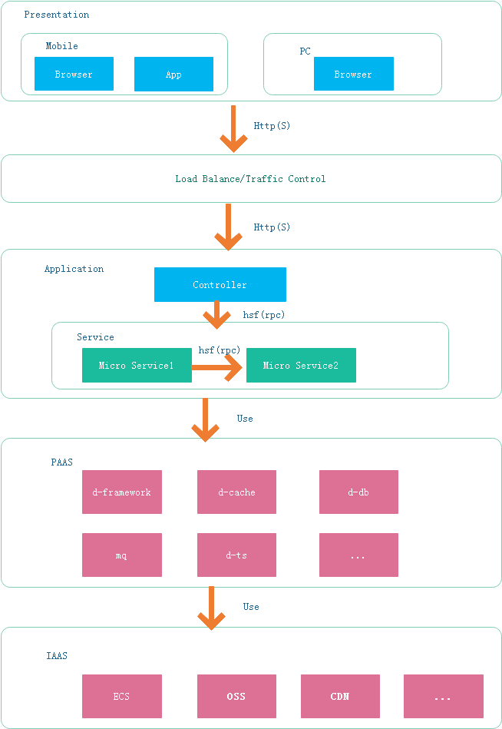
Ali-technology

Slide 24
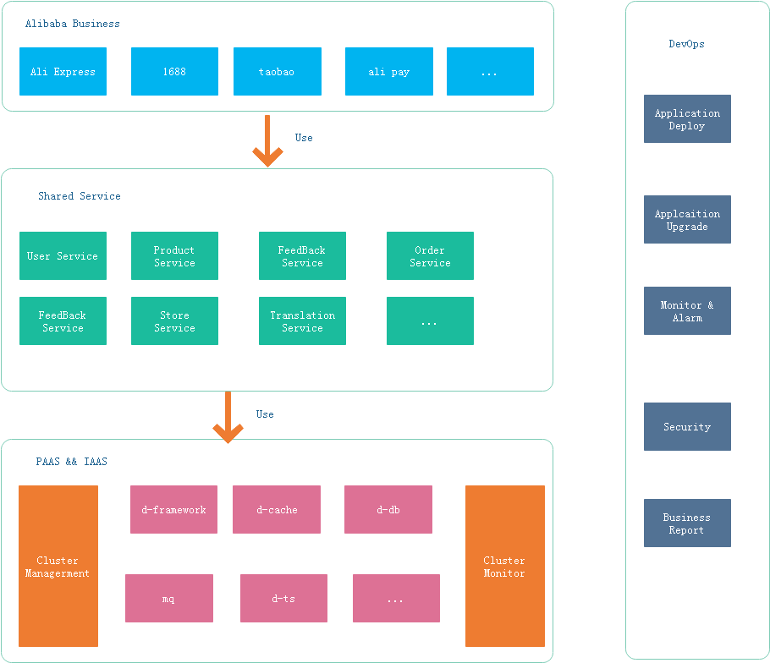
Ali-technology

Slide 25
04
How to do a project in Alibaba
PART FOUR

Slide 26
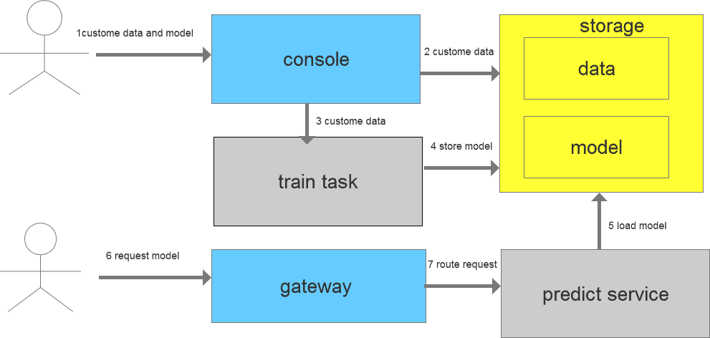
Ali-how to do project(nlp)

Slide 27
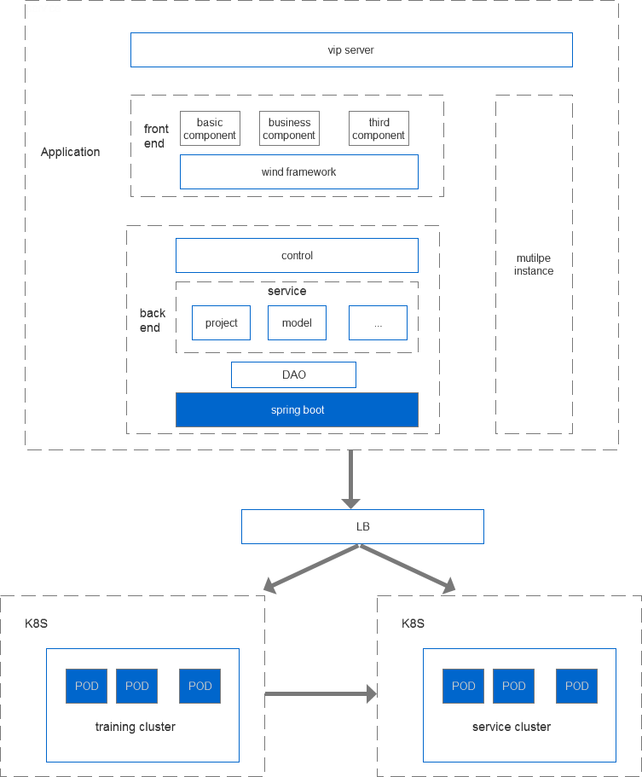
Ali-how to do project(nlp)

Slide 28
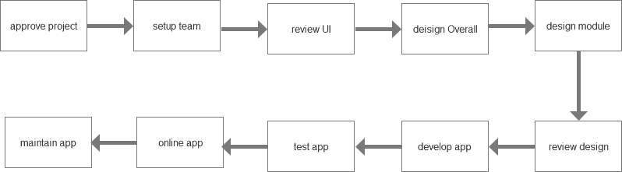
Ali-how to do project

Slide 29
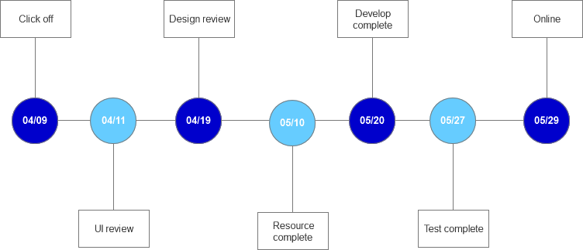
Ali-how to do project

Slide 30
Thanks
THANKS FOR YOUR TIME
李龙来(Kevin Li)
Senior Developer
Citi Tech department

